Slide 1
ROAD TO ES
How to approach Event Sourcing and (mostly) survive

Slide 2

Where it all started
Defined by Fowler in 2005
“The fundamental idea of Event Sourcing is that of ensuring every change to the state of an application is captured in an event object, and that these event objects are themselves stored in the sequence they were applied for the same lifetime as the application state itself.”

Slide 3
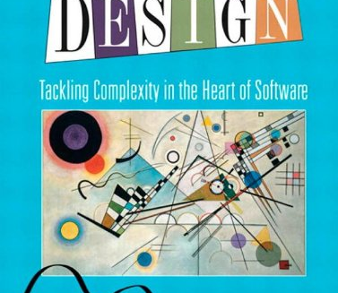
The basic ideas
DDD: Increases the Domain concept to Write and Read Models
Actors Model:
Every Domain has its own independant storage
The Domain state is changeable and visible by the external environment only through Messages
Microservices: The Read and Write models are isolated services

Slide 4

10K Feet View
Event Store
Event
API
Command Handler
Command
Write Side
Event
Read Side
Event Handler
Read Model
Data
Query Engine

Slide 5
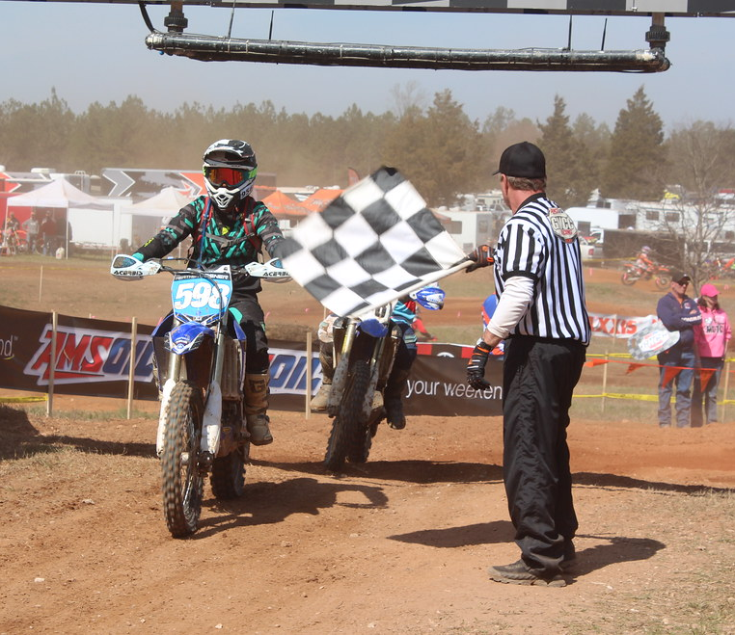
Let s’start

Slide 6
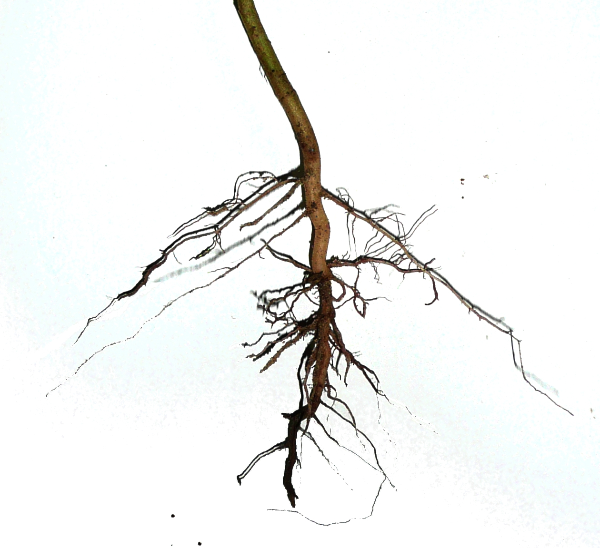
T01: The Aggregate Root
Is the main Business Entity
Given Command Methods produces Events
Contains all the data needed by the Business Logic
The name comes from the DDD terminology
Exposes Command Methods, that generate Events
Contains the state that will be written on the Write Model

Slide 7
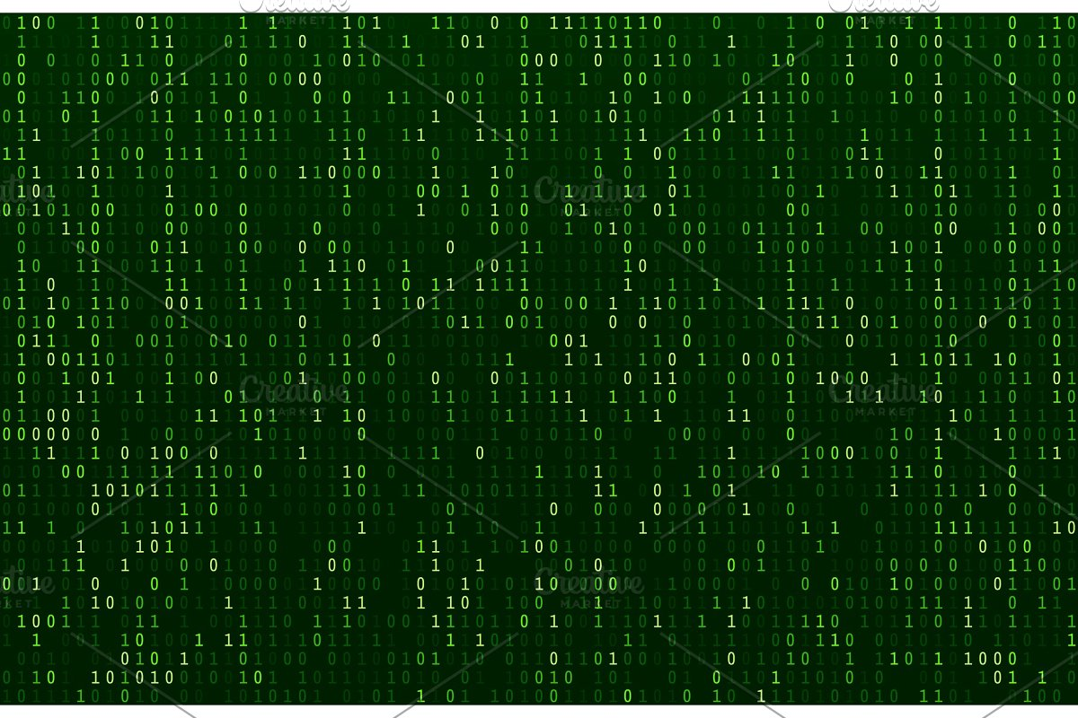
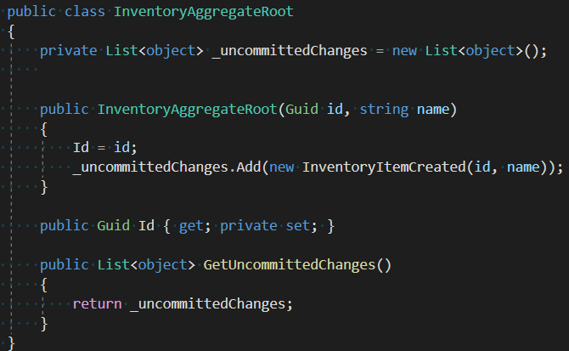
T01: The Aggregate Root

Slide 8

T01: Events
They are notifications of what is happened on the Write Model
Expressed in Past Tense “Cruise Created”
They cannot change the state of the Write Model
Contains all data changed by the Write Model
They can be spread through a Bus with Topics

Slide 9
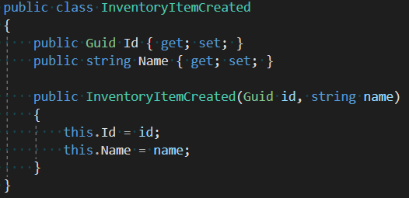
T01: Events

Slide 10
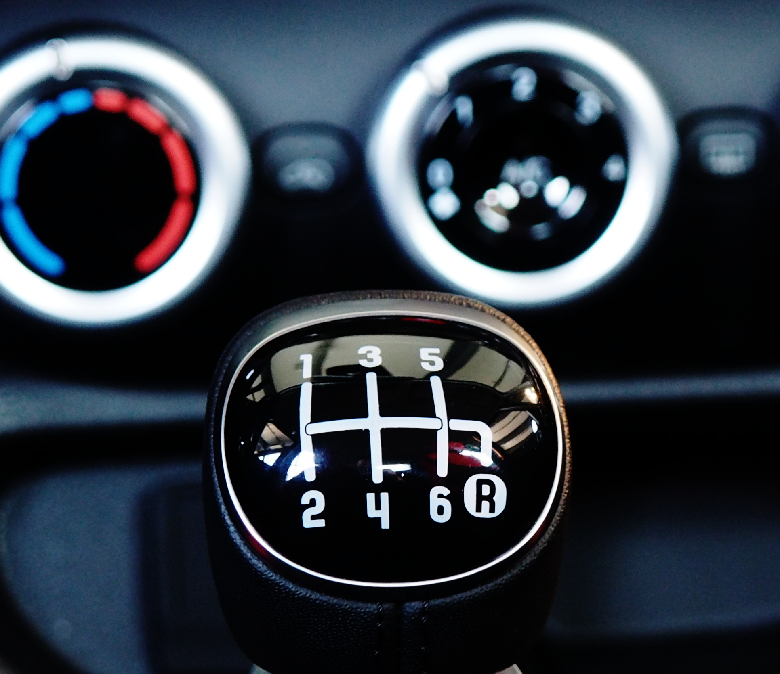
T01: The Command
Expressed in imperative like “Create Cruise”
Contains all the data needed to execute a request applied to the existing write model
To ease the implementation should be Idempotent: can be applied out of order producing the same result

Slide 11
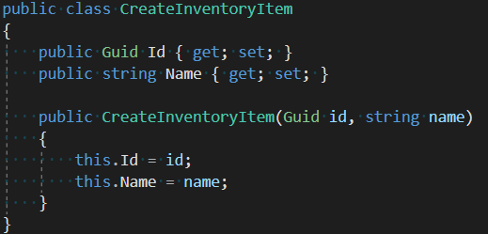
T01: The Command

Slide 12
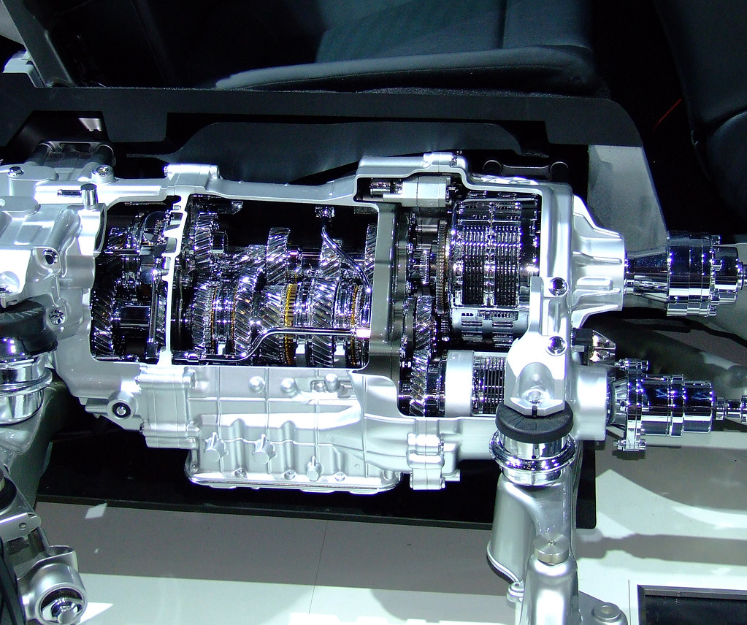
T02: The Command Handler
Receive the requests from in form of Command objects
Is the only entry point to access the Aggregate Root
Is responsible for all infrastructure-related deeds
Prepare the additional data for the Command Methods that he invokes
Mostly equivalent to the MVC controller
In this first step will store the events

Slide 13
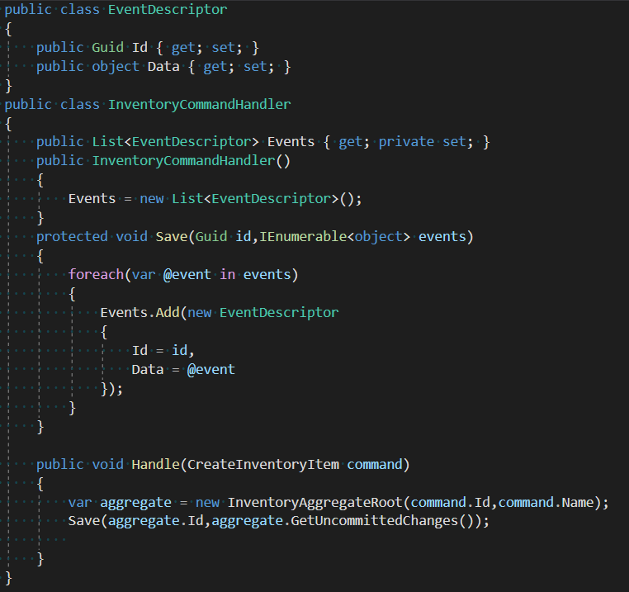
T02: The Command Handler

Slide 14

T03: Event Store
Will take the responsibility to save the stream of events
Now will be moved outside of the Command Handler following the SRP (Single Responsibility Principle)
Store the events in T-pls {id, version, type, serialized event}

Slide 15
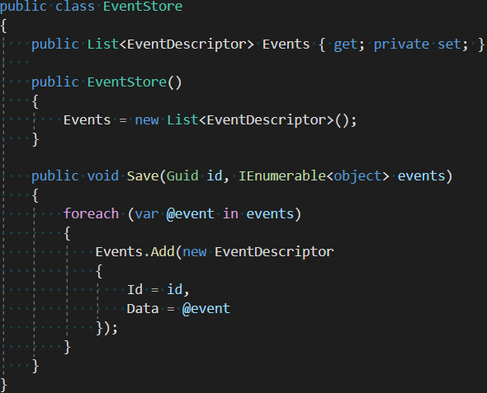
T03: Event Store

Slide 16
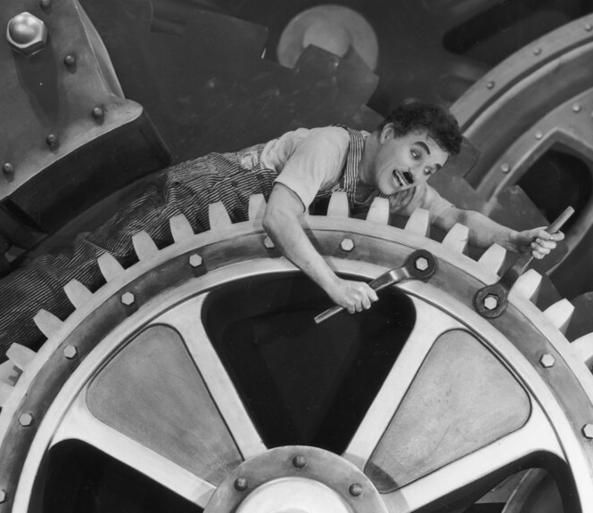
T04: Modify the aggregate
New Commands and Events will be added
The aggregate will have more methods exposed and will produce events for them
Once the events are saved the state should be reloaded via the Aggregate “LoadFromHistory”

Slide 17
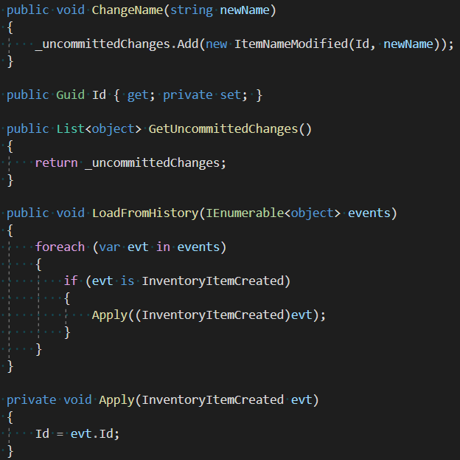
T04: Modify the aggregate

Slide 18
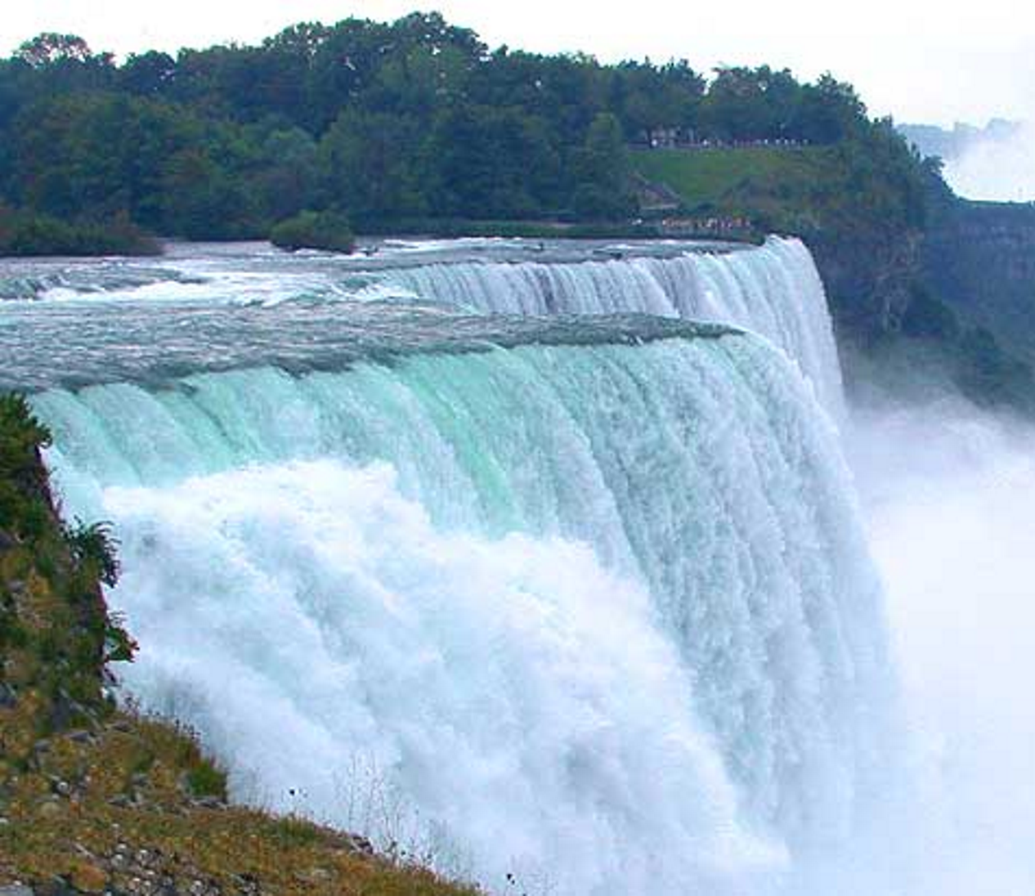
T05: Rehydration
When loading from the list of events ALL of them must be applied
The Aggregate should then handle all the event types that changes the state
Note that, until now, only the Id is a state variable. Only the create event is handled

Slide 19
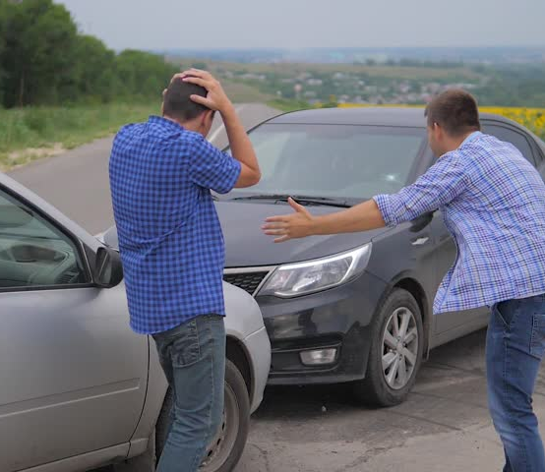
T06: Conflicts
Sending two commands on the same aggregate can lead to unpredictable results
How the uniqueness of commands can be guaranteed?

Slide 20
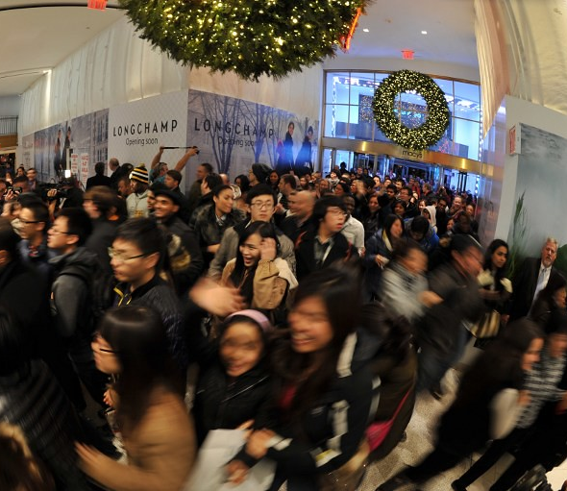
T07: Events versioning
The key on the event store will be composed by Id and Version field
Each command will carry its “Expected Version”
Only commands with the correct version can be applied
If commands are not idempotent the commands must be applied in-order

Slide 21
T07: Events Versioning
Database
Application
Last Version: 1
Retrieve
Last Version: 1
Update
Compare Last Versions
Save
Add event with Version 2
Matching
Not Matching
Last Version: 2
Error

Slide 22

T08: The Bus
We introduce the concept of Bus to
Send event to “external” systems and
Send command to Command Handlers
Should handle (at minimum)
Topics
Queues (if commands are not idempotent)

Slide 23
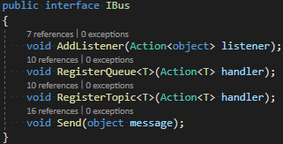
T08: The Bus

Slide 24

T09: Read (Query) Model
Ideally there is one Read Model for each type query
Represents the data in the form easiest to search with
It's like a “Materialized View”
Usually is a flat table that can be interrogated via simple SELECT (or Projections in NoSQL language)

Slide 25
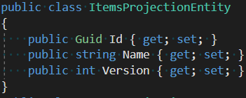
T09: Read (Query) Model

Slide 26
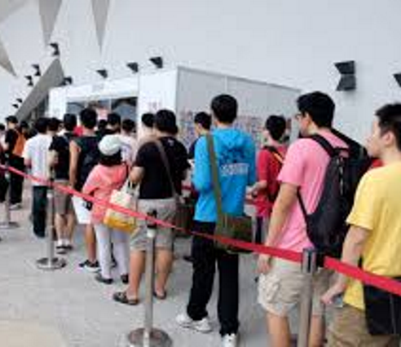
T09: Event Handlers
They build the Read Model
The receive events and create a view on data
Are similar to Data Warehouse system but in “Real-Time”
They can access external services to enrich the information received

Slide 27
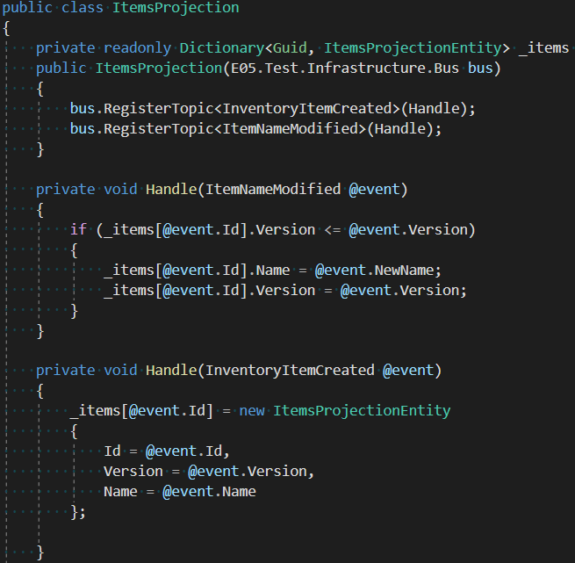
T09: Event Handlers

Slide 28

T09: The Projections
Exposes the content of the Read Model
They can be “merged” with the Event Handlers
Projections and Event Handlers should be the easiest part to write
Perfect to be left to Juniors or external teams

Slide 29
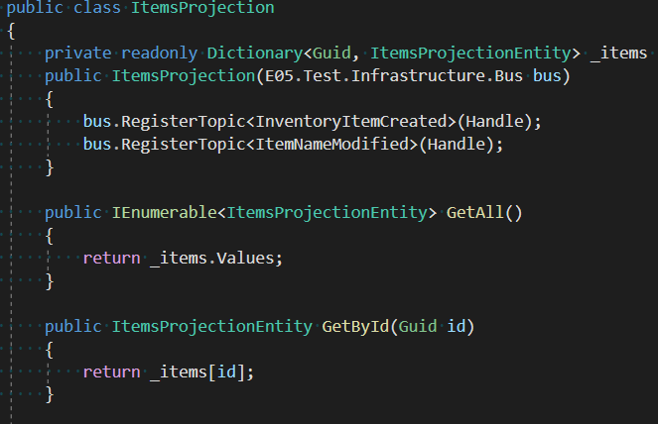
T09: Event Handlers

Slide 30
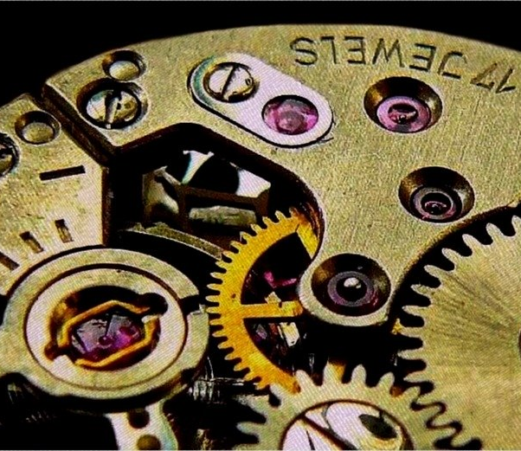
The Mythical Real-Time Db
Real-time make sense only within a defined timespan
Real time in railway systems is “in less than 350ms”
The usage of bus introduce a delay between the application of the command and the availability of the data: This is the Eventual Consistency
The same happens when locking a table for a transaction

Slide 31

Eventual Consistency
Eventual consistency is a consistency model used in distributed computing to achieve high availability that informally guarantees that, if no new updates are made to a given data item, eventually all accesses to that item will return the last updated value.
If you can’t afford a “Please re-issue your request” or “Item not available anymore…please step aside

Slide 32
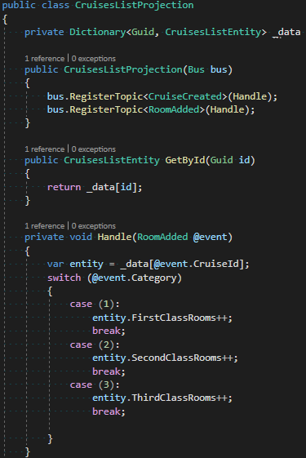
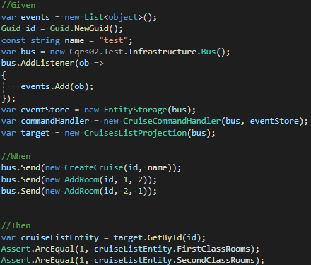
T04: Event Handlers

Slide 33
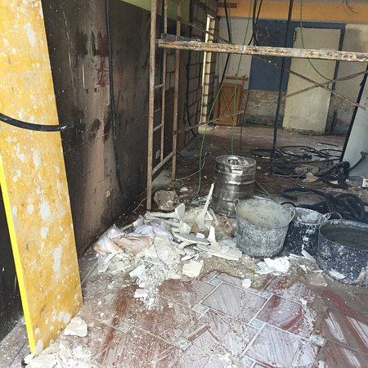
T10: Refactoring
Find all Apply invocations and store method definitions
Move all the “Apply” logic into an AggregateRoot base class
Save the correspondence between Event Name and Deserialization

Slide 34
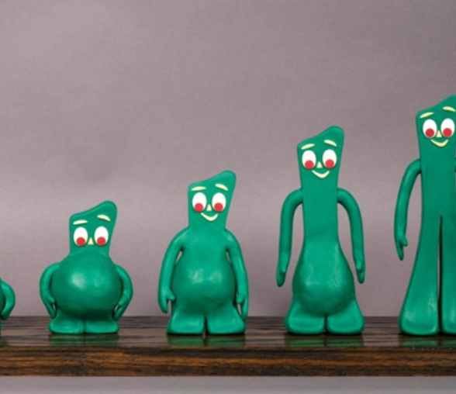
T11: Snapshots
When too much events are created you can add “Restore Points”
Save the state of the object like with CQRS
When Rehydrating
Find the last Snapshot and Apply
Start reading events
Typically the state already exists on the object

Slide 35
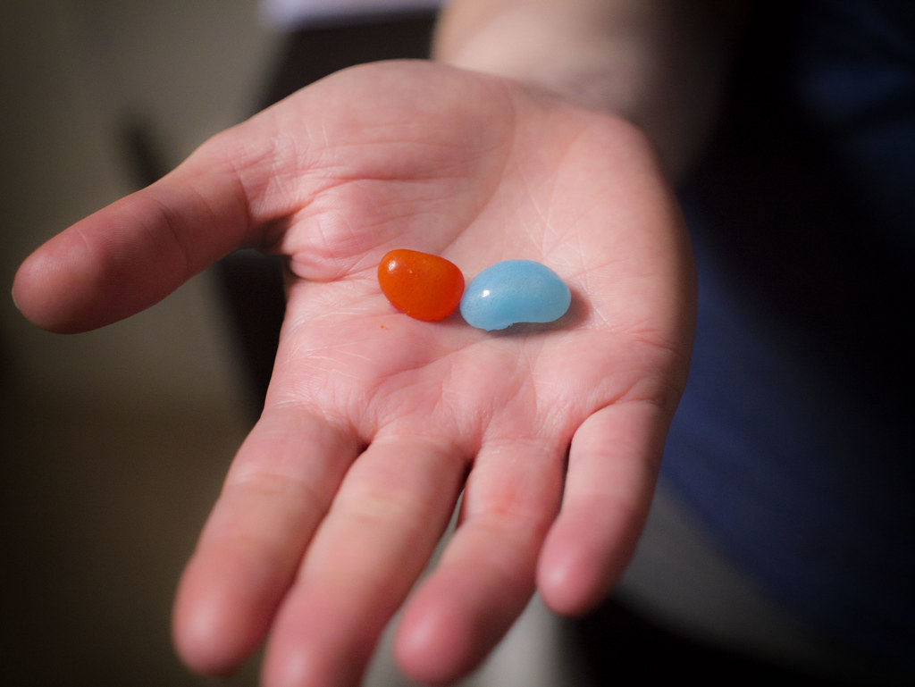
The Red Pill

Slide 36
What is missing
What we have seen until now is only a toy implementation. Several issues should be addressed e.g. (but not limited to):
Bus failures: in these examples we assume the bus never fails. We should use a subsystem that handles these situations, like a retry policy to send the Events
Messages not sent after the update (may be we should first send messages then save the data)
The “toxic” messages will be sent typically on the “Dead Letter” queues. Someone should take care of them!
Use only when fitting: an example would be a Tree data structure. Sometimes the effort to build a Domain is simply too big

Slide 37
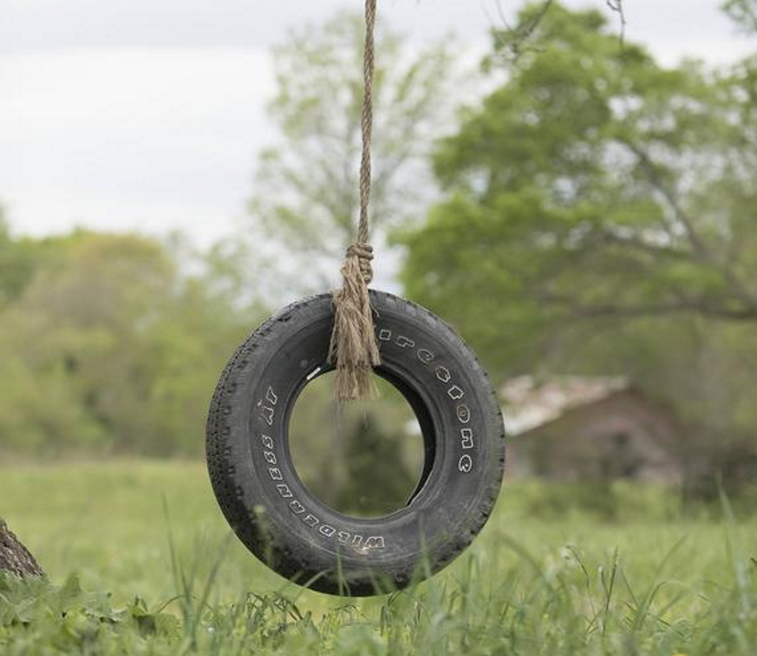
Simplest possible thing
An example from Greg Young of a simple CQRS system to handle a Warehouse, stubs based
Extended with
RabbitMQ
MongoDB
AngularJS
The new implementation can show a reliable template for a real CQRS application

Slide 38

Thank You!

Slide 39
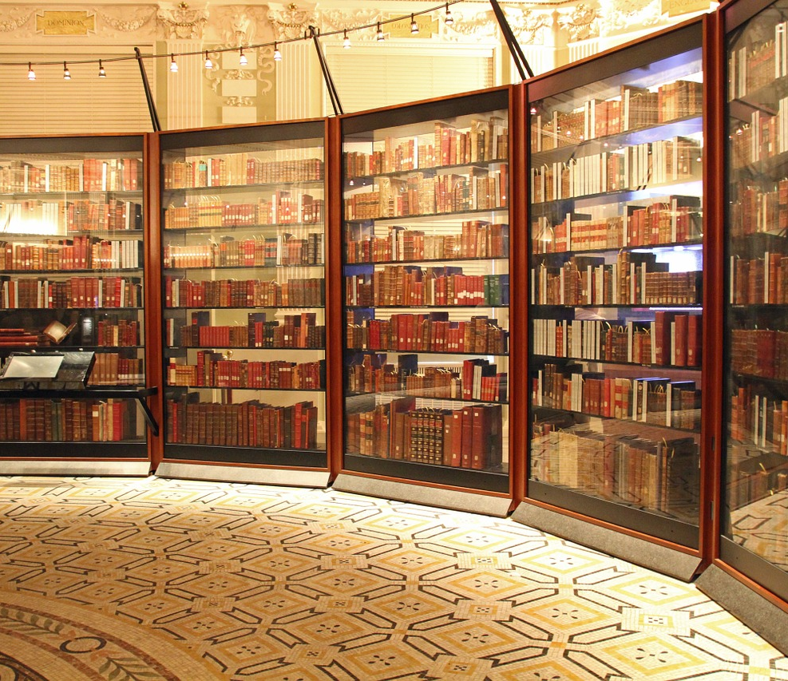
References
Eric Evans, Domain-Driven Design, Addison-Wesley, 2003
Jimmy Nilsson, Applying Domain-Driven Design and Patterns, Pearson, 2006
Vaughn Vernon, Implementing Domain Driven Design, Pearson, 2013
Greg Young’s Simplest Possible Thing (C#), https://github.com/gregoryyoung/m-r
Martin Fowler, https://martinfowler.com
Jimmy Bogard, https://jimmybogard.com

Slide 40
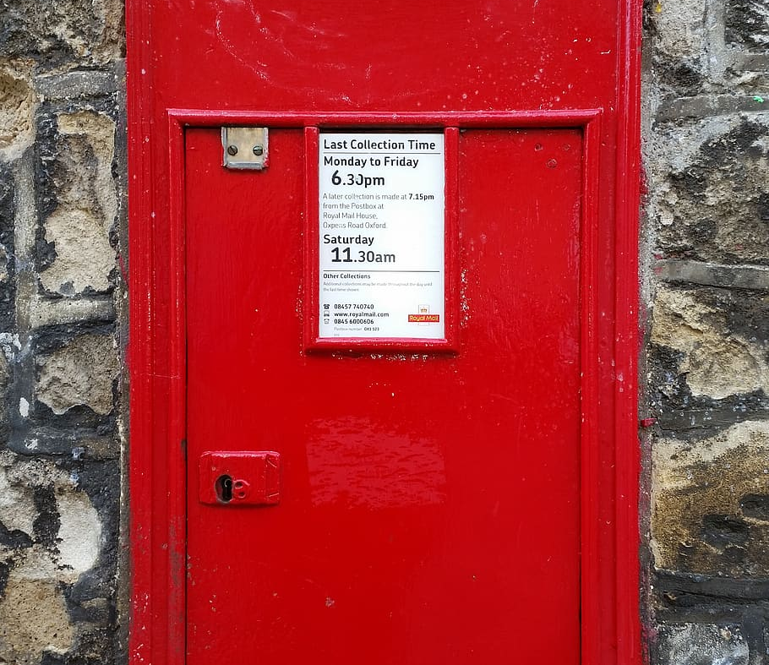
Contacts
Github: https://github.com/kendarorg
Linkedin: https://linkedin.com/enricodaros
E-mail: edr@kendar.org

